Slide 1
Sales Reflection 2016
Sales from different geographical regions

Slide 2
Have the sales remained consistent over time ?

Slide 3

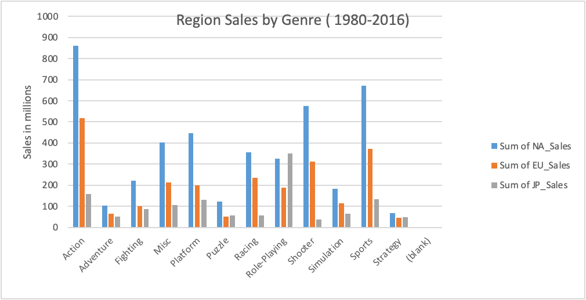
Insight for what makes the sales different in different regions Action, Shooter & Sports – dominated NA region Role-Playing – dominated JP region

Slide 4
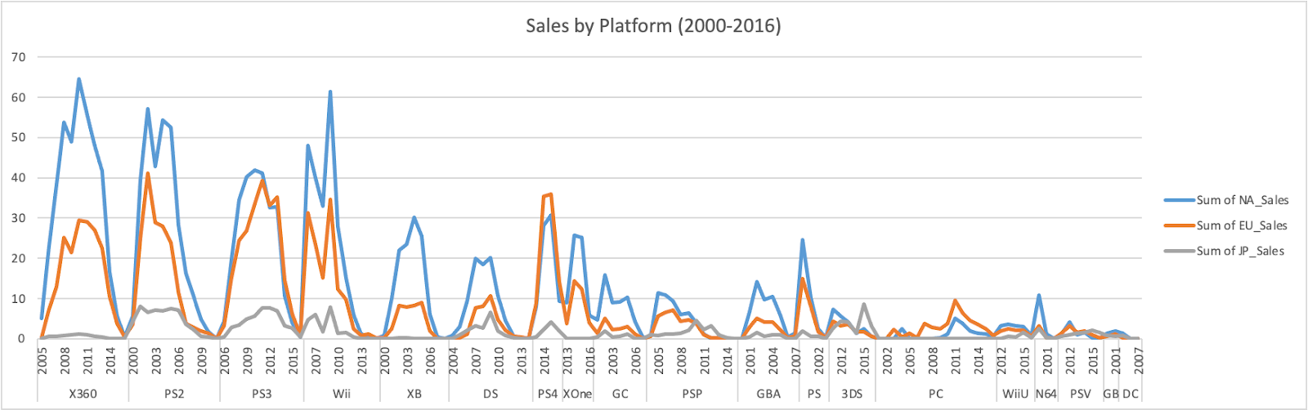
Popular Platforms of these genres that contributed to the rise in sales

Slide 5
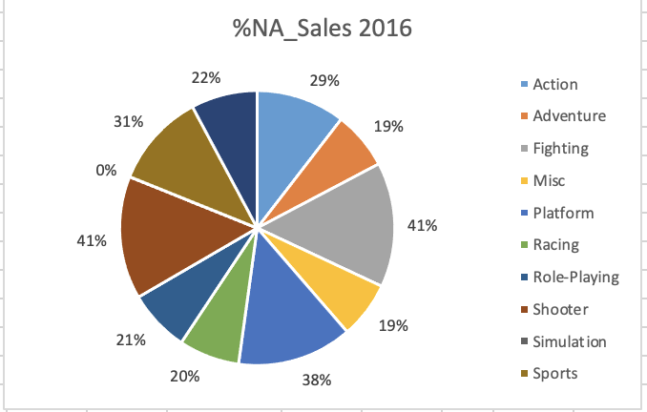
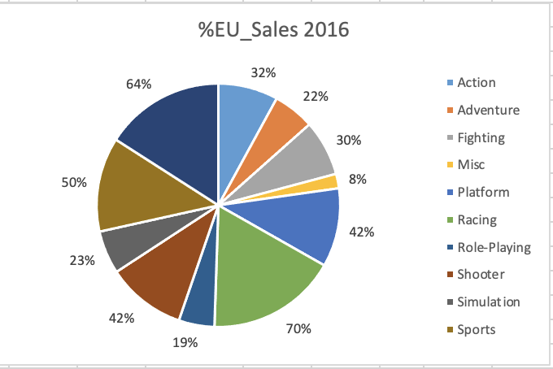
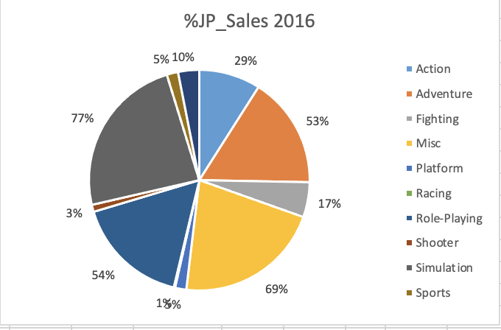
Proportion of Regional Sales - 2016
North American
Europe
Japan
North American region saw the highest sales in Fighting, Shooter &Sports Genres.
European region had the highest sales for Racing, Strategy & Sports Genres.
Japan region had the highest sales in Role-Playing and Simulation Genres.

Slide 6
Recommendations for GameCo’s. Marketing budget - 2017
As it can be clearly seen that the assumption of a steady sales is not true.
Recommended actions -
Invest in genres/platforms having highest sales in a particular region.
Consider the change in technology. Can the game be downloaded or purchased?
Leading devices used to play the games worldwide.
Most popular video game genre by age group.
Gaming console that see high rates of user engagements.

Slide 7
Thank You!

